Slide 1

ERP PROJECT
Prepared by:
Momen Othman Ali
Mayada Ali Abdel Qader
Fares Reda Al-Munir
Samir Mohammed Al-Sayed
Ahmed Abdel Rahman Ahmed
Ahmed Shoaib
Oracle E-Business Suite

Slide 2

Introduction
Oracle E-Business Suite (EBS) is a comprehensive suite of integrated, global business applications that enable organizations to make better, faster decisions, reduce costs, and streamline business processes across all areas of their operations. ERP (Enterprise Resource Planning) solutions within Oracle EBS provide a robust platform for managing critical business functions in real-time, from procurement and inventory to finance and order management.
Why Oracle EBS?
Comprehensive Integration: Oracle EBS integrates various business processes across departments, providing a unified view of organizational data. This leads to better decision-making and improved operational efficiency.
Scalability: Whether a small enterprise or a large multinational corporation, Oracle EBS is scalable to meet the needs of businesses of all sizes.
Flexibility: Oracle EBS can be customized to meet industry-specific requirements and can be deployed on-premise or in the cloud.
Key Features of Oracle EBS ERP:
Financial Management: Streamline financial operations, including general ledger, accounts payable, accounts receivable, and more.
Supply Chain Management: Efficiently manage purchasing, inventory, order processing, and logistics to enhance customer satisfaction.
Human Resources Management: Automate and manage HR processes, from recruitment to payroll and performance management.
Manufacturing & Production: Optimize production processes with tools for planning, scheduling, and controlling manufacturing operations.
By implementing Oracle EBS ERP, businesses can automate and integrate key processes, enabling them to improve productivity, reduce operational costs, and deliver better products and services to their customers.

Slide 3
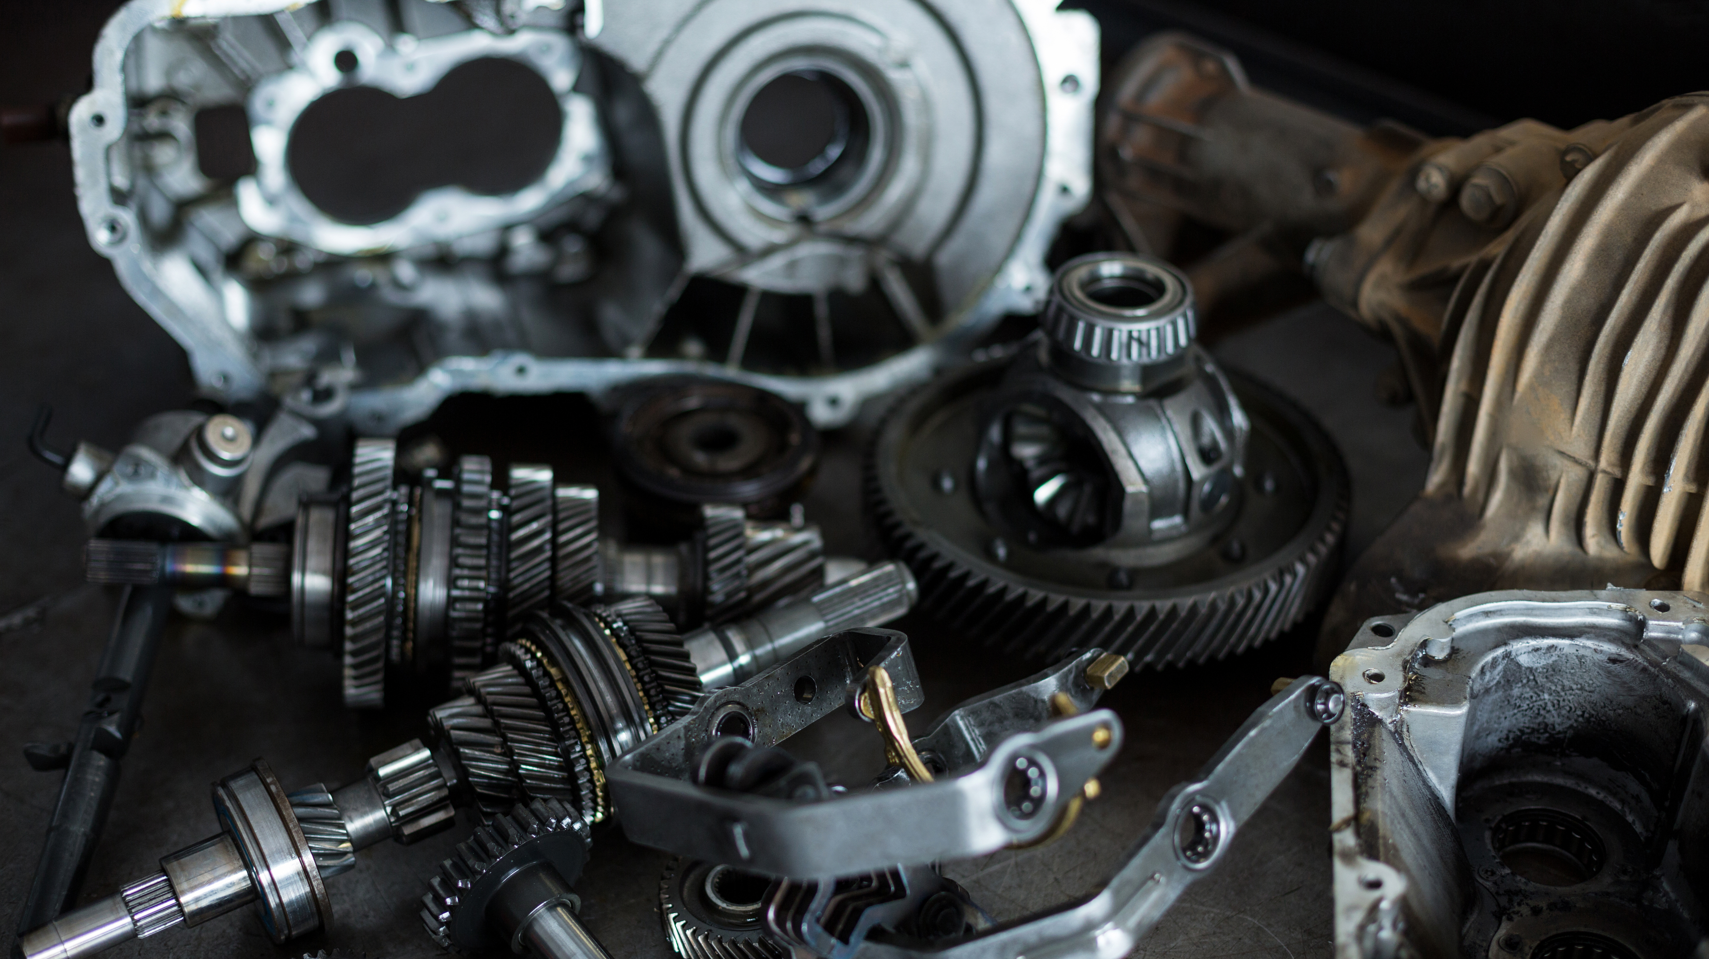
Pixel Motor Seven (BM7)
Advanced Automotive Spare Parts Manufacturing

Slide 4

About
BM7 manufactures high-performance automotive components with precision. Two primary locations:
- Location A: HQ & Main Warehouse
- Location B: Factory & Assembly Line

Slide 5
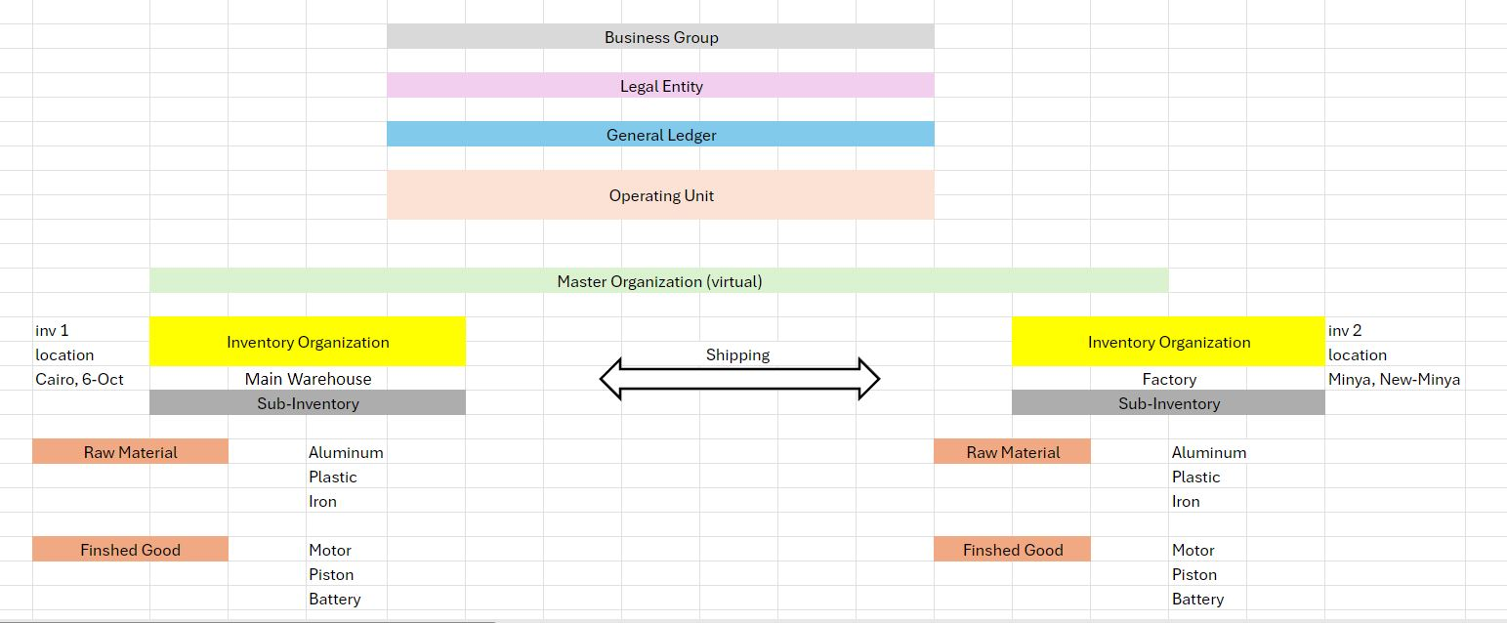
Organizational Structure

Slide 6

Items & Material
Finished Products
Engine, Front & Rear Lights, Batteries, Spark Plugs, Fuel Pumps, Filters, Belts, etc.
Raw Material
Aluminum, Plastic, Iron, etc.

Slide 7
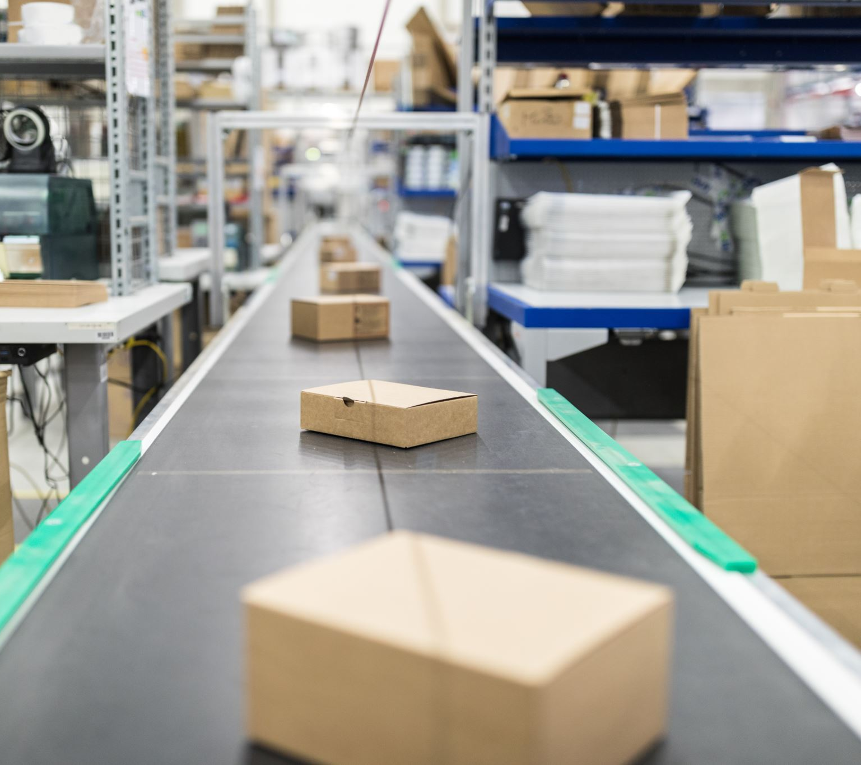
Inventory & Material Flow
Raw materials received in Location A
Transferred to Location B for manufacturing
All tracked via Oracle Inventory

Slide 8
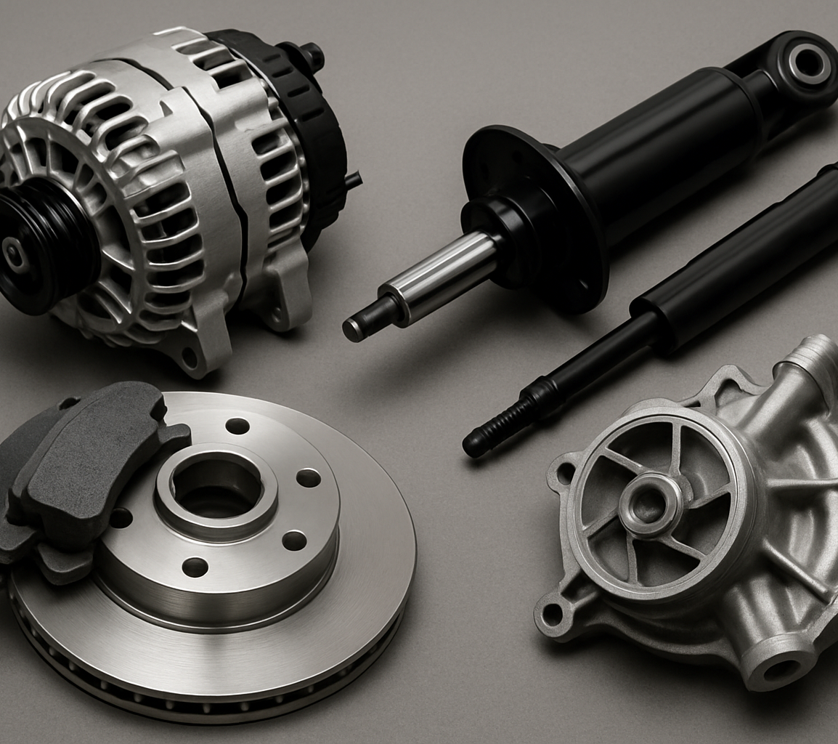
Manufacturing Workflow
Work Orders at Org B
Material Consumption
Assembly ➜ Finished Goods
Tracking through Oracle WIP

Slide 9

Oracle EBS Setup
This Setup is divided into three main sections, each focusing on the essential setups required in Oracle E-Business Suite for smooth operations across Inventory, Purchasing, and Order Management.
1- Inventory The first section focuses on Inventory Management, detailing how to configure organizational structures, define items, set up locations, and manage stock levels across multiple warehouses. Proper inventory setup ensures accurate tracking of materials and seamless operations across the entire supply chain.
2- Purchasing The second section dives into Purchasing, explaining how to define purchasing options, set up buyers, and configure approval hierarchies. It covers how organizations manage purchase requisitions, create purchase orders, and establish strong supplier relationships to ensure cost-effective and timely procurement.
3- Order Management The final section focuses on Order Management, which outlines how orders are processed from creation to fulfillment. It includes setting up order flows, sales agreements, drop shipments, and back-to-back orders. This section ensures that your order-to-cash process is optimized for fast and accurate order delivery.
Each section is designed to give you a comprehensive overview of the setup steps needed to configure these systems effectively and integrate them for maximum operational efficiency.

Slide 10
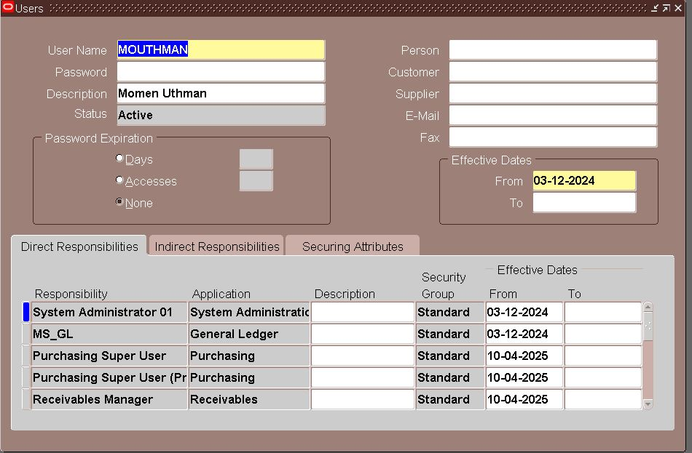
Define User
is the process of creating a new user account in Oracle E-Business Suite. This allows a person to log in and access specific responsibilities and functions assigned to them.
System administrator→ Security →User→ Define
Add Responsibilities: In the lower part of the screen, assign the responsibilities (modules) the user will access, such as:
Inventory
Purchasing
Payables
System Administrator (for admins)

Slide 11
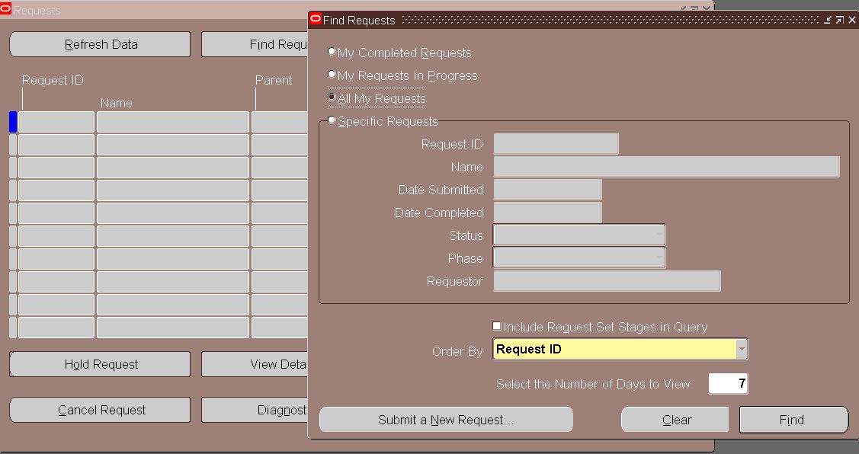
Requests
Requests are used to run background processes or reports in Oracle E-Business Suite — like generating inventory reports, creating accounting entries, or processing purchase orders.
Types of Requests:
Single Request: Run one process or report at a time.
Request Set: A group of requests that run in sequence.

Slide 12
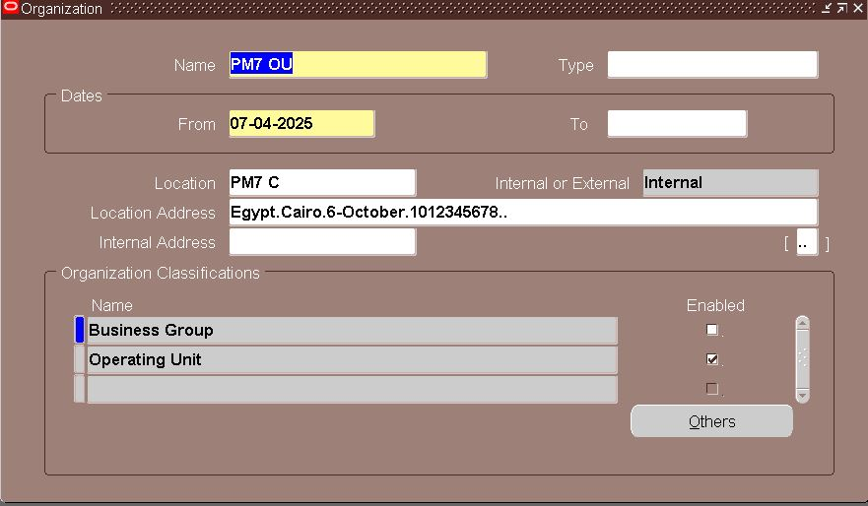
Inventory
A- Organization Setup
Define Operating Unit
Setup > Organizations > Organizations
Create Inventory Organizations (A & B)
Setup > Organizations > Organizations
Example:
Org A → Central Warehouse (Main Receiving)
Org B → Factory (Manufacturing Site)
Shipping Network
Setup > Organizations > Shipping Networks
For each direction (A ➝ B and B ➝ A):

Slide 13
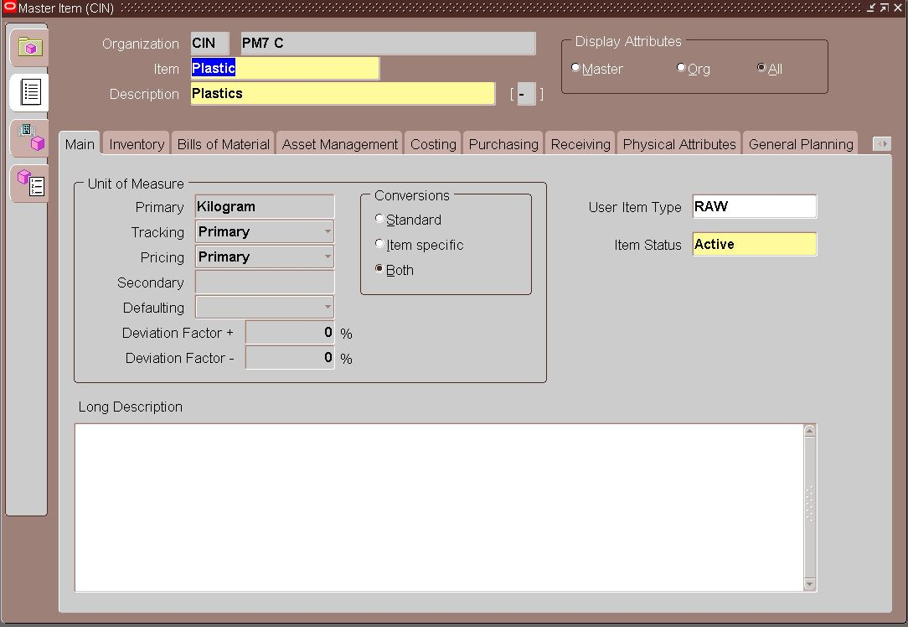
b- Item SETUP
This step is where you define your finished products (like engines, batteries, lights) and raw materials (components used in manufacturing) so they can be tracked in your inventory and used in transactions.
Items > Master Items
Example
Motor Engine 1800cc
Piston

Slide 14
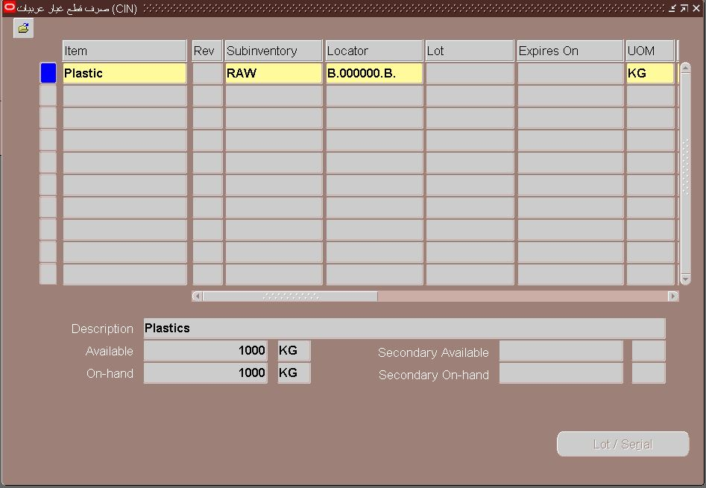
C-Transactions
In Oracle Inventory, Transactions refer to movements of items in or out of inventory, or between different locations/orgs. These are the backbone of your manufacturing company (BM7) operations — like receiving raw materials, transferring between warehouses, or issuing parts to production.
Transaction Types
Miscellaneous Receipt
Miscellaneous Issue
Inter-Org Transfer
Sub-inventory Transfer
Receiving Transactions

Slide 15

Some Elements
Move Order
Definition: A formal request to move stock inside the warehouse or between sub-inventories.
Types:
Requisition Move Order: Employee requests items.
Pick Wave Move Order: For sales order fulfillment.
Replenishment Move Order: Automatic restocking
Navigate To: Inventory > Move Orders > Transact Move Orders
On-Hand Quantity
Definition: Shows how many items are currently in stock.
Includes: Reserved, Available, Sub-inventory, Locator, Lot, Serial
View Path:
Inventory > On-hand, Availability > On-Hand Quantity
Filters:
Inventory Org
Sub-inventory
Item
Locator/Lot/Serial

Slide 16
Inventory Control
Lot Control
Definition: A Lot is a batch of items produced or received at the same time.
Purpose:
Track expiration, manufacturing dates, batch quality
Useful for items like batteries, chemicals, etc.
Enable in Item Definition:
Inventory > Items > Master Items > Inventory Tab → Check Lot Control
Set Control Level:
Full Control: Must assign a lot number for every transaction.
None: Lot tracking not needed.
Locator Control
Definition: Locators are specific locations within a warehouse (like shelves, bins).
Format: Row – Rack – Bin (e.g., A1-R2-B3)
Purpose:
Helps you find exactly where an item is stored.
Useful for large warehouses or multiple sub-inventories.
Enable in Inventory Org Setup: Setup > Organizations > Sub-inventories > Locator Control
Control Types:
Prespecified: Defined in advance
Dynamic Entry: Enter at transaction time
None: No locator required
Serial Number Control
Definition: Serial numbers track individual units of an item (like a unique engine or battery).
Purpose:
Track warranty, ownership, maintenance
Required for high-value or sensitive items (e.g., engines)
Enable in Item Definition: Inventory > Items > Master Items > Inventory Tab → Set Serial Generation
Serial Control Types:
Predefined or At Receipt/Issue
Required during transaction (e.g., WIP Completion, Sales)

Slide 17
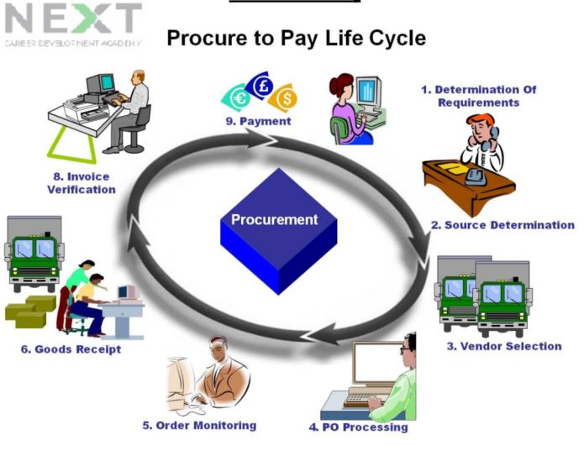
Purchasing
What is The Purchasing?
SEC (System Executive Component) Purchasing is a key module in Oracle E-Business Suite that manages the complete procurement lifecycle—from defining purchasing policies and suppliers to creating requisitions and purchase orders, receiving goods, and tracking procurement transactions.
Why It Matters
Ensures accurate, efficient, and approved procurement
Centralizes supplier and item management
Supports internal control and audit compliance
Integrates with inventory, payables, and manufacturing modules

Slide 18
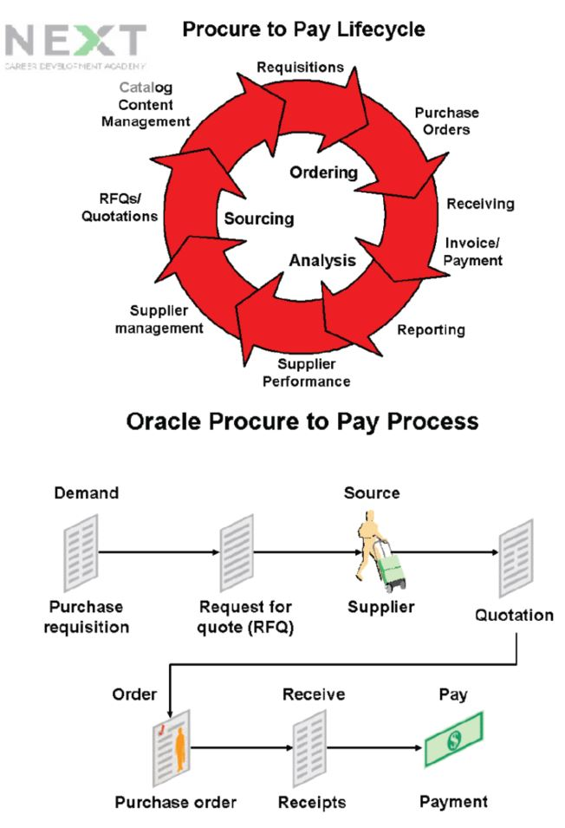
Purchasing Flow
The Purchasing Flow
Create Requisition
Create Purchase Order
Approval Workflow (Approvals and Authorization)
Receive Goods
Invoice Matching & Payment

Slide 19
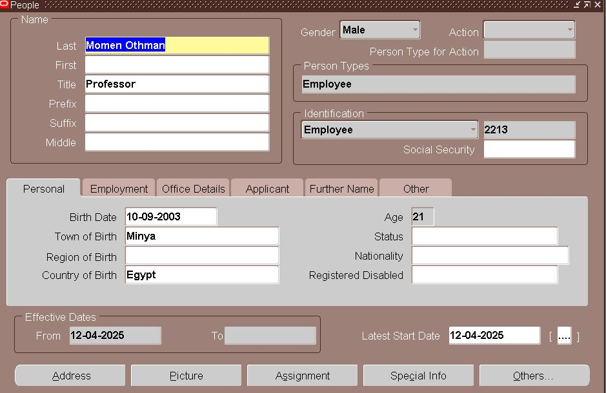
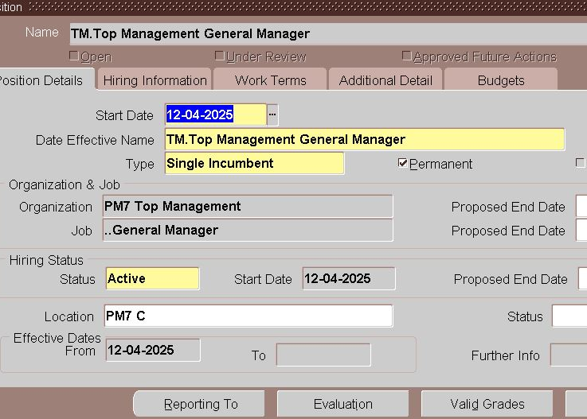
Setup
User Setup and Responsibilities
Creating Users: Define user accounts for those responsible for purchasing activities.
Creating Purchasing Responsibility (For Each OU): Assign specific responsibilities (like Buyer or Purchasing Manager) to each user.
Set Profile Option to New Responsibility: Configure profile options to customize user responsibilities and settings.
Adding Responsibility to the Users: Ensure each user is assigned the correct responsibility within Oracle.
HR and Department Configuration
Defining Department, Jobs & Positions: Structure the organization by defining job roles, positions, and departments.
Creating Employees in Oracle HRMS: Add employees to the system for the Purchasing module.
Associating Jobs & Positions with Employees: Link employee jobs and positions to their roles in the system.
Associate Employee with User IDs: Ensure each employee is associated with a corresponding user ID in Oracle.

Slide 20
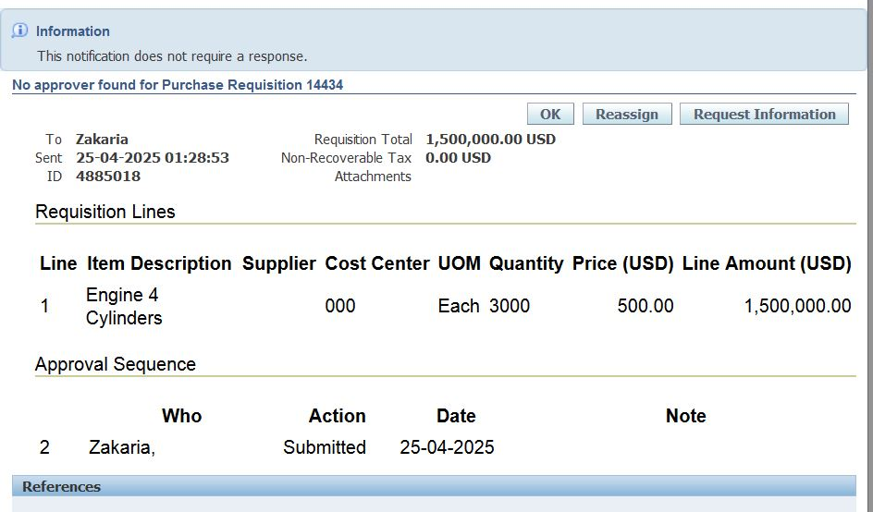
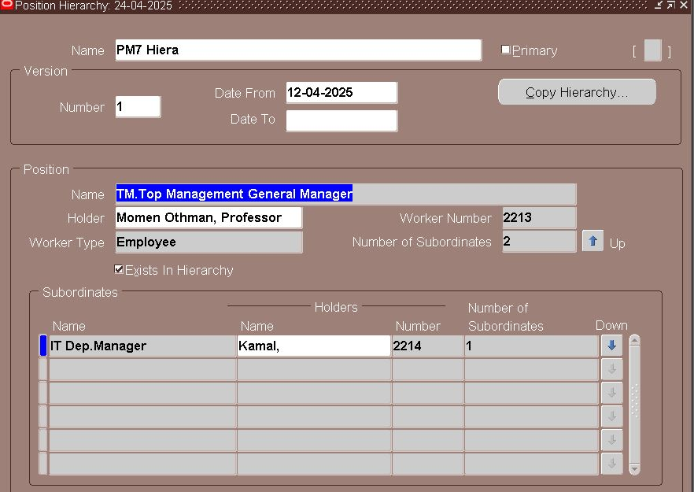
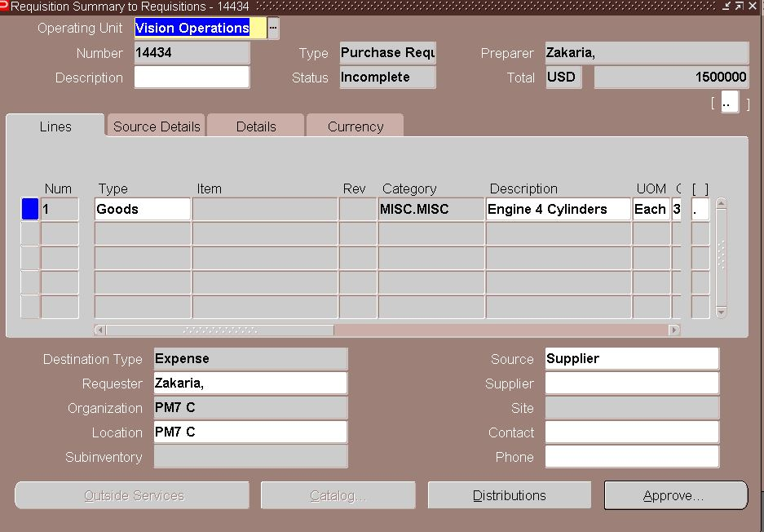
Purchasing Configuration
Defining Purchasing Parameters
Define Buyers: Specify who is responsible for purchasing within each location.
Define Financial Options: Configure financial settings, such as currency and accounting periods.
Define Purchasing Options: Set up options for purchase orders, such as document types, receiving controls, etc.
Define Document Security & Control: Configure document security settings to restrict access based on responsibilities.
Defining Approval Hierarchies for Document Approval: Set up the workflow for document approvals, ensuring compliance and control.
Defining Approval Groups & Assignments: Assign users to approval groups based on roles and responsibilities.
Managing Inventory and Periods
Controlling Purchasing Periods: Manage purchasing periods and prevent transactions in closed periods.
Define UOM’s & Conversions: Set up units of measure and define conversions for different item types.
Defining Items in Oracle Inventory: Create items for purchase and track them in inventory.
Define Multi-Org Access Control (MOAC): Configure MOAC to allow access to multiple organizations from a single responsibility.

Slide 21
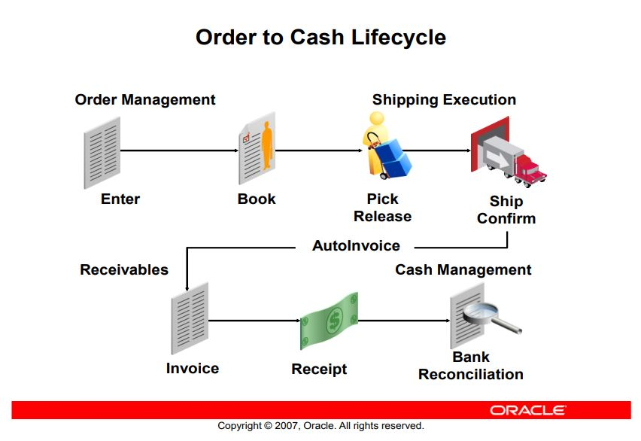
Order Management
What is SEC Order Management?
Oracle SEC Order Management is part of Oracle E-Business Suite and handles the order-to-cash process for companies. It supports all aspects of order processing, including order creation, fulfillment, invoicing, and shipping.
Importance of Order Management
Streamlines order fulfillment
Manages customer relationships
Integrates with other modules (Inventory, Purchasing, Accounts Receivable)
Ensures accurate order tracking and invoicing
Order Flow Diagram: A simple diagram showing the Order to Cash Cycle (e.g., Order → Fulfillment → Shipping → Invoicing → Payment)

Slide 22

Order Management Flows
Order to Cash Lifecycle with Standard Items
Order Creation: A customer places an order for a standard item (e.g., engine parts).
Order Fulfillment: The system checks inventory for item availability and allocates stock.
Shipping: The goods are shipped to the customer.
Invoicing: A sales invoice is generated for the customer.
Payment: The customer makes the payment, completing the cycle.
Order to Cash Lifecycle with PTO (Pick-to-Order) Items
Order Creation: A customer places an order for a PTO item (custom-built item like an engine with special configurations).
Manufacturing: Manufacturing process is triggered to create the custom item.
Shipping and Invoicing: Once the item is produced, it is shipped and invoiced to the customer.

Slide 23
Advanced Order Flows
Drop Shipments
Drop Ship Order: The customer places an order for a product that is shipped directly from the supplier to the customer.
Procurement: The order is processed with the supplier directly fulfilling the shipment.
Customer Delivery: The goods are delivered directly to the customer without going through the warehouse.
Back-to-Back Orders
Order Creation: A customer orders an item that is not in stock.
Supplier Order: The system automatically creates a purchase order to the supplier.
Inventory and Shipping: Upon receiving the item from the supplier, it is shipped to the customer directly.

Slide 24
Specialized Flows
Sales Agreements
Agreement Creation: A customer agrees to buy a certain quantity of products over a period.
Order Fulfillment: Orders are placed against the agreement as required.
Pricing and Invoicing: The agreement terms ensure correct pricing and invoicing based on the sales agreement.
Order to Cash Lifecycle with Customer Acceptance
Order Creation: A customer places an order with specific conditions for acceptance.
Customer Review and Approval: The customer reviews the order details before confirming.
Order Fulfillment and Invoicing: Once approved, the order is fulfilled, shipped, and invoiced to the customer.

Slide 25

Conclusion
In conclusion, Pixel Motor Seven (PM7) is a dynamic and innovative company specializing in the manufacturing of high-quality automotive spare parts. Through this project, we’ve detailed the operational processes, from setting up and managing inventory to streamlining purchasing and order management.
Key Highlights:
Manufacturing Excellence: PM7 is committed to producing top-tier products, including engines (1800 CC, 1400 CC, 2000 CC), front and back lights, and batteries, ensuring reliability and performance.
Advanced Operations Setup: By implementing Oracle E-Business Suite, PM7 ensures seamless integration across Inventory, Purchasing, and Order Management processes. This allows for effective management of procurement, stock, and order-to-cash flows, improving operational efficiency and customer satisfaction.
Future Growth: With the scalable solutions implemented in this project, PM7 is well-equipped to meet growing demands, expand product lines, and enhance overall business operations.
Through careful planning and the integration of robust systems, PM7 is on the path to becoming a leader in the automotive manufacturing industry. This setup not only optimizes day-to-day operations but also lays a strong foundation for long-term growth and success.

Slide 26

Thank You!
We appreciate your time and attention in learning about the PM7 project. We look forward to seeing how these processes will drive PM7 to new heights in the automotive industry.

